Slide 1

Bank Marketing (Campaign)
Data Science Final Project

Slide 2
Group Name: DataWizz
Group Members: Shiva Ramezani
Akhil Abraham
Pravallika Sheshabhatter

Slide 3
Problem Statement
ABC Bank aims to introduce its term deposit product to customers. However, to optimize their marketing efforts, the bank seeks to develop a predictive model that can determine whether a specific customer is likely to purchase the product based on their historical interactions with the bank or other financial institutions. By identifying customers with higher chances of subscribing to the term deposit, ABC Bank can focus its marketing channels, including telemarketing, SMS, and email marketing, on these prospects. This targeted approach will enable the bank to save valuable resources, time, and costs, enhancing the overall effectiveness of their marketing campaigns.

Slide 4
Data Description
The data is related with direct marketing campaigns of a Portuguese banking institution. The marketing campaigns were based on phone calls. Often, more than one contact to the same client was required, in order to access if the product (bank term deposit) would be ('yes') or not ('no') subscribed.
There are four datasets:
1) bank-additional-full.csv with all examples (41188) and 20 inputs, ordered by date (from May 2008 to November 2010), very close to the data analyzed in [Moro et al., 2014]
2) bank-additional.csv with 10% of the examples (4119), randomly selected from 1), and 20 inputs.
3) bank-full.csv with all examples and 17 inputs, ordered by date (older version of this dataset with less inputs).
4) bank.csv with 10% of the examples and 17 inputs, randomly selected from 3 (older version of this dataset with less inputs).

Slide 5
Data Description
Attributes:
Age (numeric)
Job (categorical)
Marital (categorical)
Education (categorical)
Default (categorical)
Housing (categorical)
Loan (categorical)
Contact (categorical)
Month (categorical)
Day_of_week (categorical)
Duration (numeric)
12. Campaign (numeric)
13. Pdays (numeric)
14. Previous (numeric)
15. Poutcome (categorical)
16. Emp.var.rate (numeric)
17. Cons.price.idx (numeric)
18. Cons.conf.idx (numeric)
19. Euribor3m (numeric)
20. Nr.employed (numeric)
21. Output: Y (binary) -
Subscription to term deposit ('yes' or 'no')

Slide 6
Data Preprocessing
Steps taken:
Checking for NULL value: No Null value was found
Distribution visualization
Checking skewness and its visualization
Checking the correlation
Checking for outliers
Checking if the dataset is balanced
Using SMOTE approach to overcome the imbalance
OneHotEncoding the dataset
Splitting the data into test & train

Slide 7
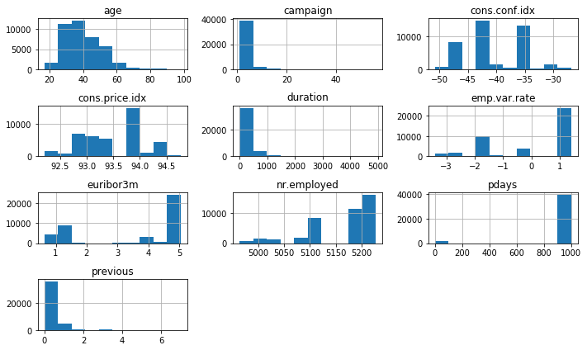
Exploratory Data Analysis (EDA)
Data
Distribution
Visualizations

Slide 8
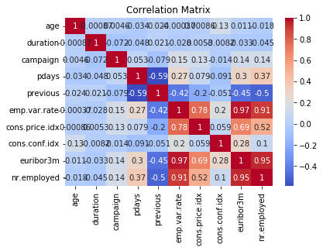
Exploratory Data Analysis (EDA)
Data
Correlation

Slide 9
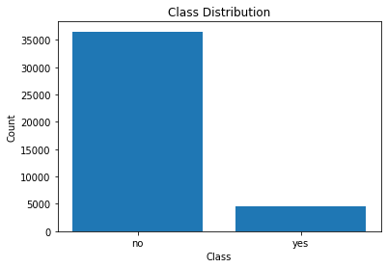
Exploratory Data Analysis (EDA)
Balance
or
Imbalance

Slide 10
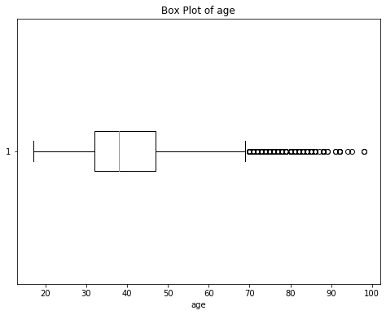
Exploratory Data Analysis (EDA)
Outlier Detection

Slide 11
Model Building
The banking problem we are working on is classification. Therefore, we have chosen the following algorithm:
Random Forest
XGBoost
Logistic Regression
SVM
Neural Network

Slide 12
Evaluation Metrics
Precision
Recall
F-1 Accuracy
Accuracy
ROC AUC Score
Confusion Matrix

Slide 13
Results
Model/ Evaluation | Accuracy | Precision | Recall | F1-score | ROC AUC | Confusion Matrix
Logistic Regression | 0.864 | 0.863 | 0.864 | 0.863 | 0.934 | [6335 997] [ 989 6299]
SVM | 0.822 | 0.899 | 0.725 | 0.802 | 0.935 | [6739 593] [2002 5286]
Random Forest | 0.917 | 0.6808 | 0.498 | 0.575 | 0.945 | [7091 217] [ 465 463]
XGBoost | 0.919 | 0.919 | 0.548 | 0.604 | 0.948 | [7062 246] [ 419 509]
Neural Network | 0.44 | 0.444 | 0.48 | 0.4615 | 0.4720 | [20 30] [26 24]

Slide 14
Conclusion
Based on the evaluation metrics, the Logistic Regression model outperformed all other machine learning models for this specific problem. It achieved the highest values for accuracy, precision, recall, F1-score, and ROC AUC among all the models tested. Hence, the Logistic Regression model is the best-performing model for predicting whether a customer is likely to subscribe to the term deposit, and it is recommended for deployment in ABC Bank's marketing efforts.
The results may vary for different datasets or scenarios, so it's essential to thoroughly analyze the performance of each model based on the specific requirements and objectives of the project.

Slide 15
Thank you!

